Slide 1

Stage 4 Three Many Choices Course Designer: Jordan Rogers
Three Many Choices is a 37 round, 185 point Comstock long course. There are 9 USPSA targets, 7 IPSC targets, 4 steel targets, and a single Clay. The best two hits per target will score. Steel must fall to score. Clay must be shot to score but is a bonus target. The start signal is audible.
The start position is standing anywhere within any shooting area. Handgun loaded and holstered OR PCC loaded with safety on, stock on belt, and muzzle pointing down range. Your second firearm is UNLOADED and staged in dump box.
On the audible start signal, engage targets from within the shooting areas. USPSA targets may be engaged with PCC ONLY. IPSC targets may be engaged with Handgun ONLY. Steel may be engaged with either Handgun or PCC.

Slide 2
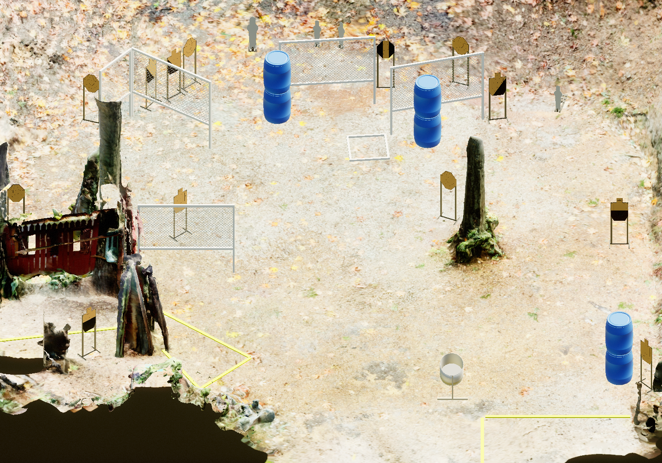
 | Stage 4 Three Many Choices Course Designer: Jordan Rogers

